Slide 2
Abstract :
We present a basic calculator web application, designed and developed using HTML and CSS. This calculator performs fundamental arithmetic operations, including addition, subtraction, multiplication, and division. The user interface is intuitive and easy to use, with a clean design that showcases the capabilities of HTML and CSS in building functional and visually appealing web applications.

Slide 3
Introduction :
In this project, we leverage the power of HTML and CSS to create a simple yet functional calculator. Our goal is to demonstrate the potential of these technologies in building interactive web applications. The calculator is designed to be user-friendly, with a straightforward interface that allows users to perform basic arithmetic operations with ease. By utilizing HTML for structuring content and CSS for styling and layout, we have created a calculator that is both functional and visually appealing. This project serves as a testament to the capabilities of HTML and CSS in building web applications that are both practical and aesthetically pleasing.

Slide 4
Project Description :
The goal of this project is to design and develop a simple calculator using HTML, CSS, and JavaScript.
The calculator should be able to perform basic arithmetic operations such as addition, subtraction, multiplication, and division.

Slide 5
Flow chart
Yes
If o/p=‘E’
Input a,b
No
choose
(o/p)
Menu
+: Addition
-: Subtraction
*: Multiplication
/: Division
E: Exit
C=a+b
C=a-b
C=a*b
C=a/b
Print Sum
Print Diff
Print Multi
Print Div
Stop

Slide 6
Project Design:
The project consists of three main components:
HTML Structure: The HTML structure consists of a container element that holds the calculator interface. The interface is divided into two main sections: the keypad and the display screen. The keypad contains buttons for numbers 0-9, basic arithmetic operations, and a clear button. The display screen shows the input numbers and the result of each operation.
CSS Styling: The CSS styling is used to design the layout and appearance of the calculator interface. The keypad buttons are styled to resemble a traditional calculator keypad, and the display screen is styled to show the input numbers and results clearly.
JavaScript Functionality: The JavaScript functionality is used to handle user input and perform the arithmetic operations. When a user presses a button, the corresponding JavaScript function is called to perform the operation. The result is then displayed on the display screen.

Slide 7
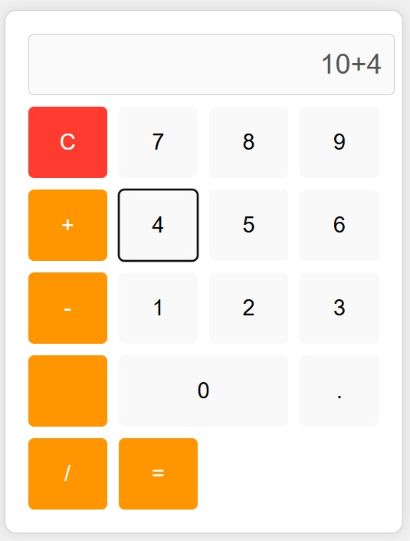
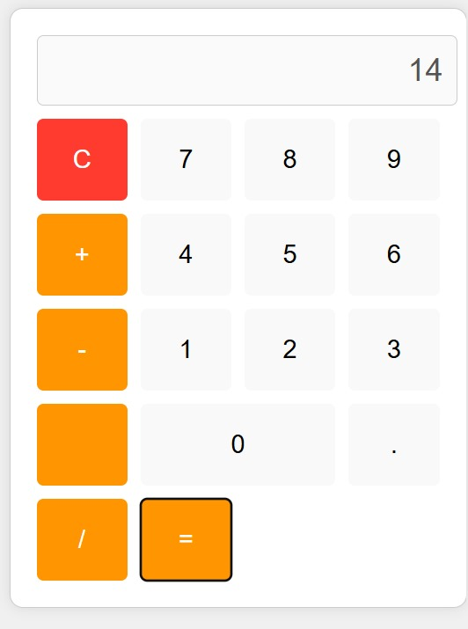

Slide 8
Project Conclusion :
The simple calculator project using HTML and CSS is a basic calculator that can perform basic arithmetic operations. The project demonstrates the use of HTML and CSS to design and develop a user-friendly interface. The project can be further improved by adding more features such as memory functions, trigonometric functions, and error handling.

